Slide 1



Alekhya Rambatla
Aparna Vaidyanathan
Geethika Banda
Harsha Kadiyala
Jahnavi Srinivasan
ISMG 6450 IT Project Management
Fall 2018

Slide 2
Executive Summary
What inspired to initiate this program?
Objective
Vision
Mission
Notes:
Project Objectives
The objective of this project is to design and build two classrooms with 5 kiosks in two state penitentiaries where students can get the information related to the course. Provide internet and projectors so that a professor can take remote classes. Provide education to inmates and award completion certifications
Project Vision and Mission
The mission of the project is to equip the prisoners with education and change the criminal mindset when they rejoin the society. No prisoner should be again going back to penitentiary for committing a crime just because they don’t have any source of income and any skills to sustain in the society. Eventually we want to reduce recidivism and possibly take it to zero. We promise the inmates future with education.

Slide 3
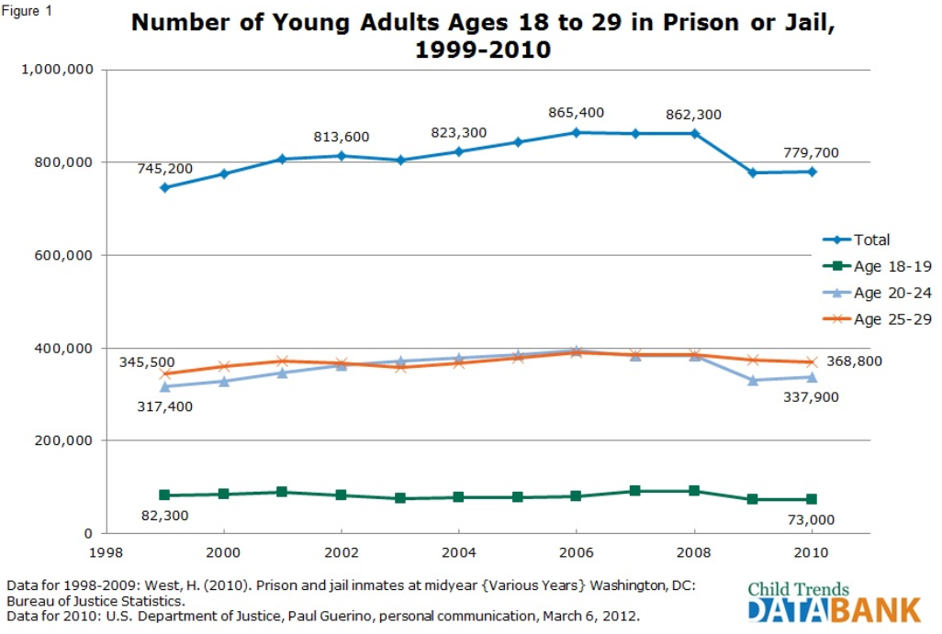
incarceration rates
Millennials incarceration are
shockingly high.
93% of prisoners are male
30% of male are millennials
Source: Department of justice statistics as of 2010

Slide 4
Integration management
Preliminary Scope Statement
Project Plan
Execution
Monitor & Control
Change Management
Closure
Notes:
Project Scope Management includes the processes required to ensure that the project includes all the work required, and only the work required, to complete the project successfully. Managing the project scope is primarily concerned with defining and controlling what is included in the project. The project scope management is organized by the following project management processes:
Collection of Requirements- Plan Scope
Scope Definition
Creation of WBS
Scope Verification
Scope Control

Slide 5
Project Scope
Detailed Scope Statement
In-scope and out of scope items
Project Budget and overall timelines
Notes:
Project Budget
The total project is estimated at $120,000 which includes expert judgement and 50% of expert guestimate. This does not cover operational costs after the project go-live and post production support is complete.
Scope Statement
As part of this project a robust prison education system will be created in collaboration with UC Denver. Couple of two new classrooms will be built with needed infrastructure. Course curriculum will be developed. Computer kiosks will be made available to the inmates. Below is the detailed scope and out of scope items.
Below are the items that are in scope:
In this phase only two state penitentiaries in CO are in scope.
Select and build two 400 ASF (assignable square feet) rooms with projector, 40 chairs per room for each prison. (Total 160 chairs, 4 rooms, 20 computers, 4 projectors)
Providing Broadband internet connectivity and procuring one projector per class room.
Coordinate with universities to develop curriculum
Install computers and the software needed for students to communicate with professor and complete any assignments.
Procure any special software needed as course demands.
Distribute course completion certifications.
Install required security software so that prisoners will not have wide access than needed to complete the course.
Offer any help needed by inmates through emails or live chat on need basis.
Below are out of scope:
Prisons excluding the selected establishment in the state of CO.
Safeguarding the classroom, computers or any assets from physical abuse and its prison’s guard’s responsibility to secure the assets and infrastructure.
Monitoring and taking action on students’ conduct is out of scope
Maintenance of the product or classrooms are not part of this project. The assumption is that department of corrections will contract the maintenance to some other vendors

Slide 6
Program logo
The program logo was designed to echo the objective, vision and mission as well as social responsibility. Each individual image and color signifies very important core values
Green (X & Y Axis): Caring for the environment and promoting ‘Go Green’.
Black: Piercing the darkness by attaining the knowledge through education
Red: Removing the barriers to get the wisdom.
Orange: Combine the energy of red and happiness of yellow.

Slide 7




Program logo
: Signifies X and Y axis relates to science and mathematics
: Signifies throwing the bright light for the future.
: Prison bars with a hole of hope to get out with education.
: Graduated Inmates/Prisoners
: Educational tools needed to survive in the world.

Slide 8

Stakeholders
H.O.D of Corrections (Sponsor)
Dean, UC Denver
Justice Dept. Head
Construction Manager
Operations Manager
PMO Lead
Inmates
Program Architect
Build Lead
Prison Warden
Prison Security Head
IT Director
Training Co Ordinator
Professors
Quality Lead
Procurement Manager
Change Manager

Slide 9
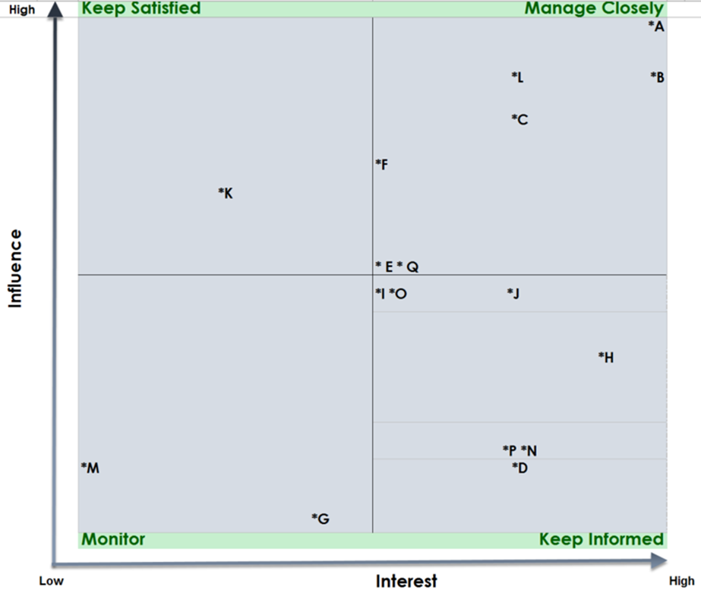
Stakeholders
A - H.O.D of Corrections (Sponsor)
B - Dean, UC Denver
C - Justice Dept. Head
D - Construction Manager
E - Operations Manager
F - PMO Lead
G - Inmates
H - Program Architect
I - Build Lead
J - Prison Warden
K - Prison Security Head
L - IT Director
M - Training Co Ordinator
N - Professors
O - Quality Lead
P – Procurement Manager
Q – Change Manager

Slide 10

Communication management
OUR OBJECTIVES :
Build an effective team
Making things clear
Managing Diversity
Dealing with problems
Surviving Catastrophe
Simplicity
Make sure each member is easily accessible

Slide 11
Communication plan
Information Required (the message) | Information Provider (the sources) | Frequency | Expected effect | Method of Communication (the media) | Project Steering Committee | Project Sponsor | Project Core Team | Design Team | Test Team | Business Team | System Users | IT Director | Dean, UC Denver | Juctice Dept. Head | Construction Manager | PMO Lead | Operations Manager | Inmate | Build Lead | Prison Wardon | Prison Security Head | IT Director | Training Cordinator | Professors | Procurement manager | Change Manager
Project Start* | Sponsor / PM | Once, just after making approvals | Establish project organization and timelines, common understanding and alignment of expectations | Occasional video conference,bi weekly email updates & ocassional team meetings | X | X | X |  |  |  |  |  | X
Project Status Updates* | PM | Monthly | Awareness of project status, risks and issues involved in providing education to inmates | Project Status Report in Share Point location, export to XL sheets and notify by email | X | X | X |  |  |  |  | X
Project Core Team Updates | PM | Weekly | Common understanding of project status, completed and upcoming activities, risks and issues | Discussion of project progress, risks, issues, mitigations, face to face and/or Skype for Business online meeting |  |  | X |  |  |  |  |  |  |  |  | X |  |  |  |  |  | X |  |  | X
Technical Team Meetings | Build Lead Manager | Bi-weekly | Discuss issues, and risks of inmates within technical team. | Stand up meetings, face to face and/or skype for business meeting |  |  |  |  |  |  |  |  |  |  |  |  |  |  | X |  |  |  |  |  |  | X
Design Team Meetings | Design Lead | Bi-weekly | Discuss about issues, and risks involved within prison and inmates. | Stand up meetings, face to face and/or skype for business meeting |  |  |  | X |  |  |  |  |  |  |  | X |  |  |  |  |  |  |  |  |  | X
Test Team Meetings | Test Manager | Bi-weekly | Discuss about issues and risks of current work within the group. | Routine meetings, face to face and/or online meeting |  |  |  |  | X

Slide 12
Communication plan
Information Required (the message) | Information Provider (the sources) | Frequency | Expected effect | Method of Communication (the media) | Project Steering Committee | Project Sponsor | Project Core Team | Design Team | Test Team | Business Team | System Users | IT Director | Dean, UC Denver | Juctice Dept. Head | Construction Manager | PMO Lead | Operations Manager | Inmate | Build Lead | Prison Wardon | Prison Security Head | IT Director | Training Cordinator | Professors | Procurement manager | Change Manager
Business Team Meetings | Business, Project Manager/(BSA's) | Bi-weekly | Brainstrom about ideas,discuss issues, and risks of current work packages within business team. | Routine meetings, face to face and/or online meeting |  |  |  |  |  | X |  |  |  |  |  |  |  |  | X
Project Steering Committee Updates | PM | monthly/ milestones based | Common understanding, approval of scope, time and budget alignments | Discussion of project progress, risks, issues, mitigations and potential scope, time or budget alignments | X |  |  |  |  |  |  | X
Promotion(Marketing) | PM / Directors | If required | Project marketing, information and awareness for interested stakeholders regarding Promising future for inmates | Email, App promotion,Company Newspapers | X | X | X |  |  |  | X | X |  |  |  | X |  |  |  |  |  | X
Go-Live* | Sponsor / PM / Leads | Once, short before Go-Live | Awareness and project marketing | Communication of Project Go-Live, by email and other news channels | X | X | X |  |  |  | X | X |  |  |  | X |  |  | X |  |  | X
Project Close | PM | Once, to formally close the Project | Lessons Learned, termination of project organization | Project Close-Out Meeting, face to face and/or online meeting | X | X | X |  |  |  |  |  |  |  |  |  |  |  |  |  |  | X
Training Documents | Change Manager | Every 6 months | Training Documents related to the Product | Roadshow and News lestters | X | X | X | X | X | X | X | X | X | X | X | X | X | X | X | X | X | X | X | X | X | X

Slide 13
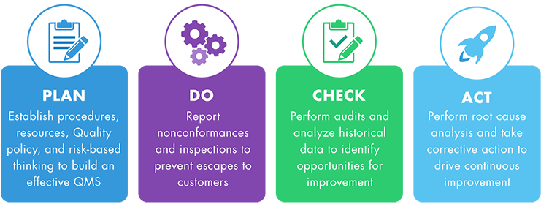
QualityPlanning: defines quality goals for overall project plan
(That’s what we want to achieve)
QualityControl: constructive measures (That’s how we have to work)
QualityInspection: analytical measures
(Have we achieved the goals? Have we worked correctly?)
QualityImprovement: Continuous Management measures
(That’s how we can improve!)
Quality Management
Quality Planning
Quality Control
Quality Inspection
Quality Improvement

Slide 14
Quality Management
Milestone | Quality Checklist Items
Analysis for setting up training kiosks at the prison | Document current systems Discussions with stakeholders Set up the execution plan Budgeting
Contracts | Project funds Procurement supplies Employ the team
Online portal development | Course development GUI Implementation Testing the deliverables
Training the professors | Course walkthrough Handling prisoners
Implementation of classroom | Setup the infrastructure (construction, furniture, computers)
Progress Check | Support the service 24*7
Project closure | Improvement measures

Slide 15
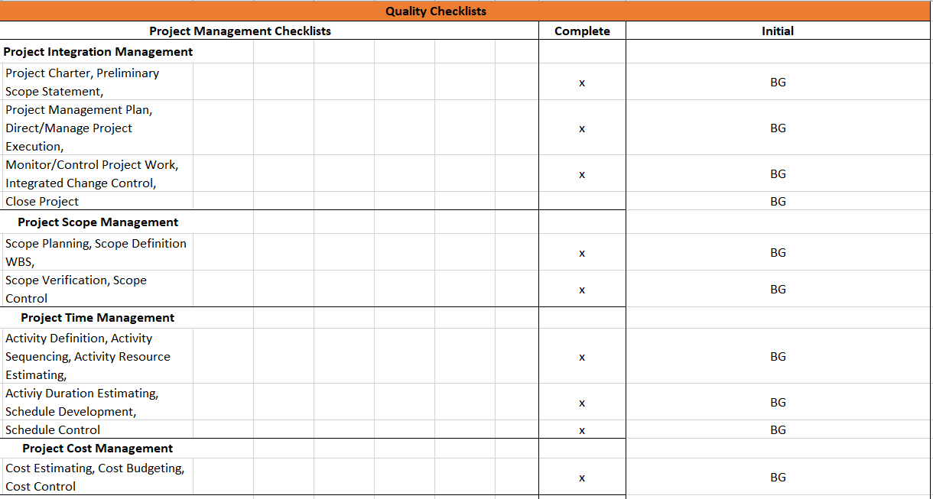
Quality Management

Slide 16
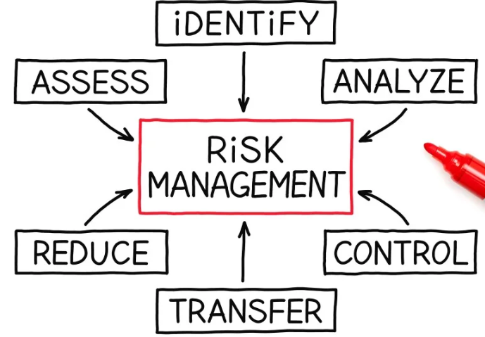
RISK Management
1- Align risk with the organization’s strategy
2 – Define what decisions to take in response to the occurrence of risks
3- Reduce contingencies and losses in the operation
4- Identify and manage diversified risks
5- Seize opportunities
6 – Potentiate the use of capital

Slide 17
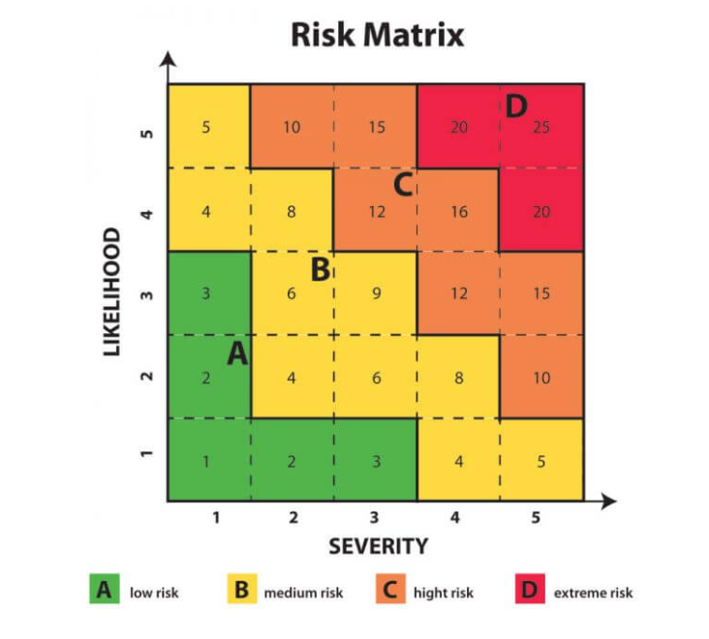
RISK handling
The objective of the Risk Matrix is to indicate 4 possible risk levels for each event, depending on its frequency and severity.
Low risk
Medium Risk
High risk
Extreme Risk

Slide 18
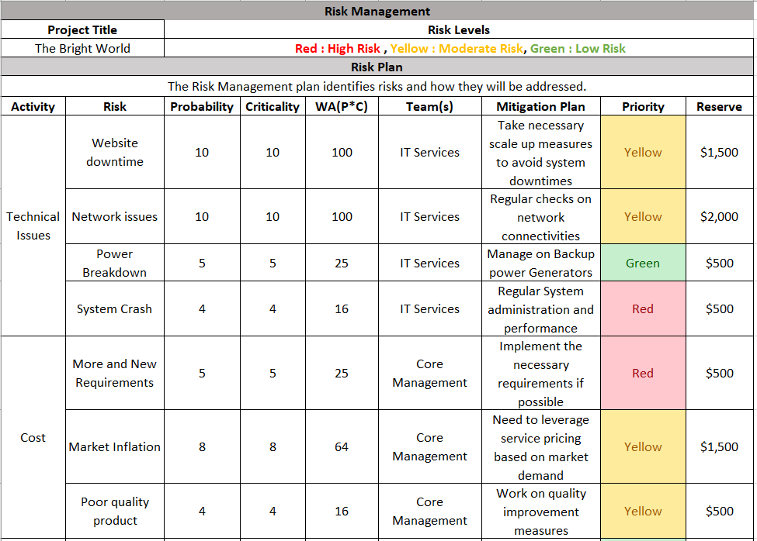
RISK Management plan

Slide 19
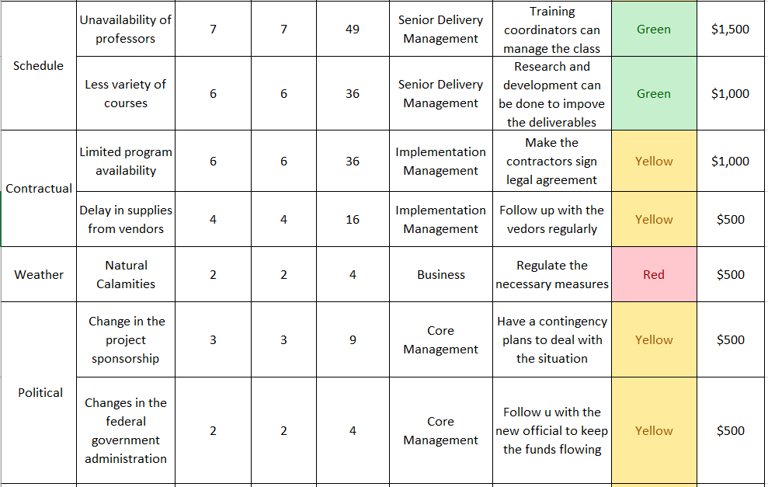
RISK Management plan

Slide 20
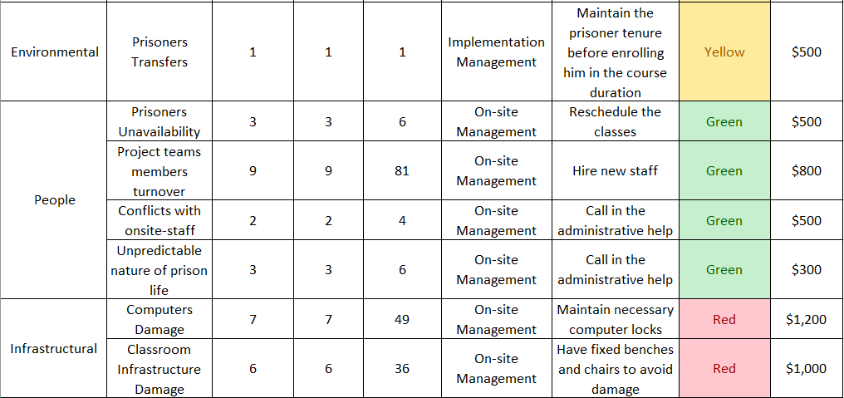
RISK Management plan

Slide 21
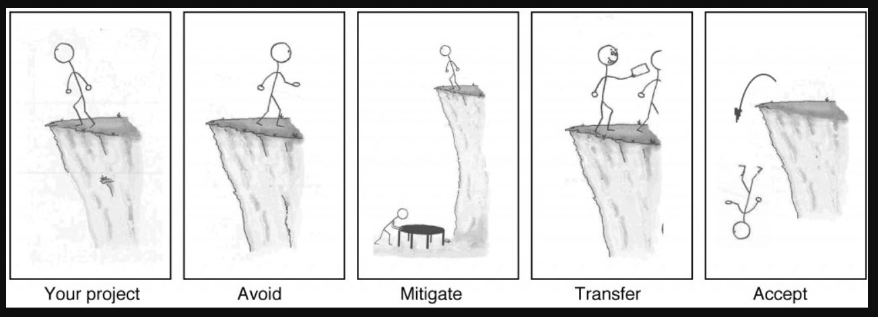
RISK mitigation
Avoid:
The best thing you can do with a risk is avoid it. If you can prevent it from happening, it definitely won’t hurt your project. The easiest way to avoid this risk is to walk away from the cliff, but that may not be an option on this project.
Mitigate:
If you can’t avoid the risk, you can mitigate it. This means taking some sort of action that will cause it to do as little damage to your project as possible.
Transfer:
One effective way to deal with a risk is to pay someone else to accept it for you. The most common way to do this is to buy insurance.
Accept:
When you can’t avoid, mitigate, or transfer a risk, then you have to accept it. But even when you accept a risk, at least you’ve looked at the alternatives and you know what will happen if it occurs. If you can’t avoid the risk, and there’s nothing you can do to reduce its impact, then accepting it is your only choice.

Slide 22


Time management
Overall duration of the project is 6 months. What are we taking into account?
Project Critical Milestones
Task priority
Order of Execution
WBS chart
Duration Estimates
Project Schedule
Gantt chart

Slide 23
Time management
Finalize Design
Budget Approval and Receive Grants
Classroom Construction Completed
Resources Procured
Classrooms open for Inmates
Project charter/ Contract Approval
Handover classrooms
Project Milestones
Notes:
Project charter/Contract Approval This is the first and critical milestone where the contract and procurement plan for construction and set up of the classroom will be analysed,finalized and approved by the UCD and all vendors for the build process.
Finalize Design In this milestone, the design/structure for curriculum for the inmates' education, classroom types and facilities, Software will go through three phases namely preliminary, revised and final. Once the final design documents are ready, they will be approved.
Budget Approval and Receive Grants This is the milestone to assess the financial requirements, frame an overall budget for the process involved untill the project handover, get approval and receive grants from the state Government.
Classroom Construction Completed In this milestone, first phase of the construction will be completed where two classrooms would be ready for the fixtures and hardware setup
Resources Procured All resources required for safety, lighting,thermal, hardware , software, furnitures will be procured
Classrooms open for Inmates This milestone marks the end of the construction phase. The classrooms will be ready with kiosks set up for education.
Handover classrooms The final milestone will be achieved by after inspection and verification. The classrooms will be handed over to begin the official teaching for inmates.

Slide 24
Work Breakdown structure
Inmate Classroom Design & Build
Contract Administration
Requirement Assessment
Contract Negotiation
Financial Resource Planning
Needs & Assessment
Design Architecture
Construction Phase 1
Procurement
Construction Phase 2
Construction/ Procurement Plan
Contract Approval
Execution
Revision & Amendments
Auditing
Grants
Budgeting
Curriculum Design
Classroom Structure
Software
Safety monitoring Equipment
Furniture
Electronics
Site Selection & Land Acquisition
Spatial Organization
Rooms
Facilities
Fixtures
Hardware Installation
Software Installation
Miscellaneous Finishing
Completion
Contract Closeout
Dry run & Inspection

Slide 25
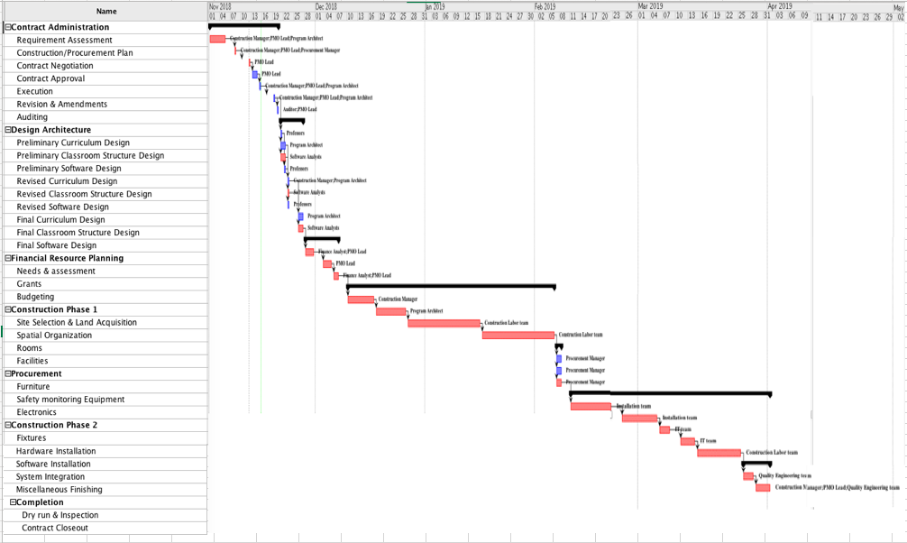
Gantt chart

Slide 26
Human resource management
Resource planning
Organizational Structure
Team members roles & responsibilities
Responsibility Matrix
Execute the plan
Acquire & Develop the project team
Monitor & Control the plan
Manage the project team
Plan
Execute
Monitor & Control

Slide 27
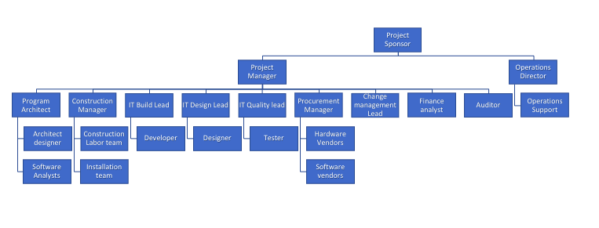
Human resource management
Organizational Chart

Slide 28
Team Roles & responsibilities
ROLES | RESPONSIBILITY
Project Manager | Manages project initiation, planning, design, execution, monitoring, controlling and closure of a project
Program Architect | Bridges the boundaries between engineering and project management, leading the technical workers who contribute to the building of structures or products
Architect designer/Software Analysts | Create plans, drawings, and layouts for buildings and landscapes/design and develop software systems and applications.
Construction Manager | Oversee specialized contractors and other personnel
Labors/Installers | Physical labor on construction sites/Carpentry & Electrical fixtures
IT team | Build, Design ,integrate and test software and IT services
Procurement Manager | Directing purchasing agents and buyers throughout the process of evaluating suppliers, conducting interviews with vendors, negotiating supplier agreements and managing supplier and vendor contracts
Hardware/Software Vendors | Supply Hardware/Software Products
Change Management Lead | Meet objectives on time and on budget by increasing employee adoption and usage
Finance analyst | Improve financial status by analyzing results; monitoring variances;recommending actions to management
Auditor | Ensure obligations are met and value is realized
Operations Director/Support | Assists upper management in setting goals ; Oversees daily activity of the team; Prepares budgets, schedules, and other organizational reports as needed

Slide 29
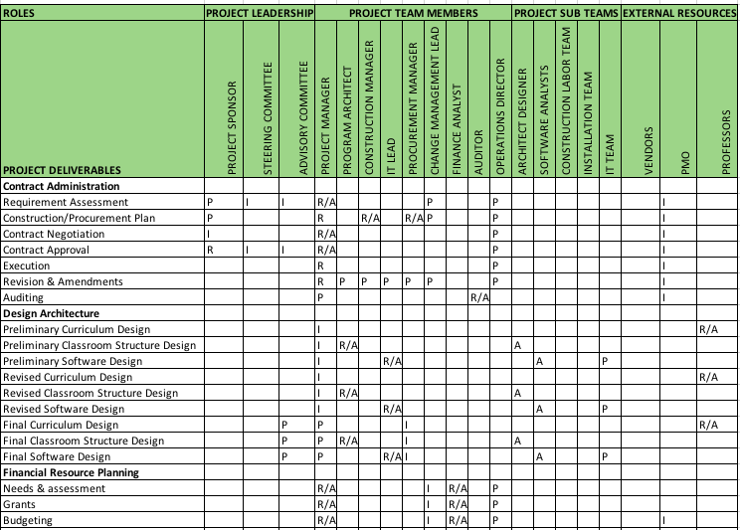
Responsibility matrix
R-Responsible
A-Accountable
P-Participant
I-Informed

Slide 30
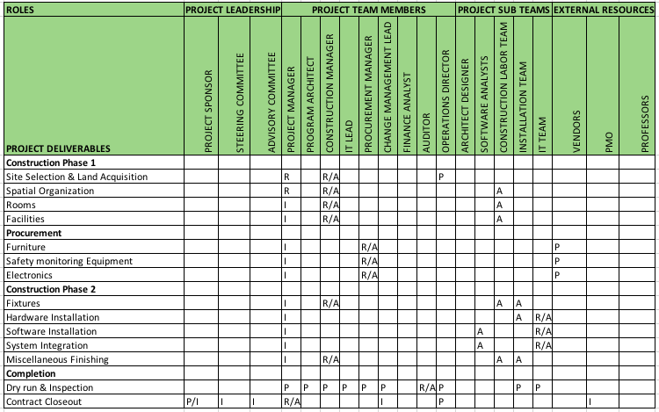
Responsibility matrix
R-Responsible
A-Accountable
P-Participant
I-Informed

Slide 31
COST Management
Plan
Estimate cost
Cost Types
Developmental
Operational
Resources
Budget
Identify allowable overhead ~ 0.2% of cost
Control cost
Identify estimation processes
Reporting
Cashflow
EV vs PV
PV vs AC
Planned costs
$120,589
Proposed budget
$144,706

Slide 32
COST Management

Slide 33
Procurement Management
Plan
- Delivery schedule
- Perform audits
Closure
Monitor
Execute
- Identify products
- Identify strategy
- Assess vendors
- Select vendors
- Closure of project
- Warranty
period

Slide 34
Procurement Management
Item # | Items | Contract Type | Order date | Delivery date
1 | Networks and communication | Time & materials | 11/01/18 | 11/08/18
2 | Development/QA Servers | Fixed price | 11/01/18 | 11/08/18
3 | Computer peripherals - keyboard, monitor, mouse, mousepads | Fixed price | 11/03/18 | 11/08/18
4 | Furniture for Office space, chairs and desks | Fixed price | 11/01/18 | 11/08/18
5 | UX - Custom icons for the application | Fixed price | 12/06/18 | 01/10/19
6 | Construction raw materials for 4 rooms | Fixed price | 11/01/18 | 11/08/18
7 | Projectors - 4 | Time & materials | 11/08/18 | 11/08/18
8 | Hardware integration | Time & materials | 02/21/19 | 03/21/19
9 | IT Misc. - Special software, certification partners | Time & materials | Need basis | Need basis
Vendor Selection for Construction materials
Criteria | Weight (in %) | Scores (5 - Excellent, 4 - Good, 3 - Average, 2- Below average, 1-Bad)
 |  | Summit Materials Inc | Wylaco | Rio Grande Co | James Lobello | Gumer Concrete LLC
Availability | 30 | 3 | 4 | 3 | 2 | 4
Quality of the Product | 25 | 4 | 4 | 2 | 3 | 3
Pricing | 25 | 2 | 5 | 2 | 3 | 4
Past performance | 20 | 3 | 5 | 1 | 2 | 5
 |  | 3 | 4.45 | 2.1 | 2.5 | 3.95

Slide 35
THANK YOU

